Slide 1
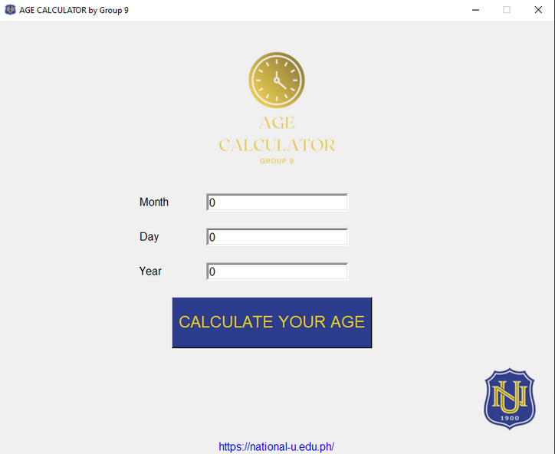
AGE
CALCULATOR
INF 221
GROUP 9

Slide 2
Description
1
GUI (graphical user interface)
4
CALCULATE FUNCTION
We use tkinter because it makes it simple and quick to develop GUI applications.
We utilize the def keyword to include things inside of it like a graphical user interface (GUI), a program window, a logo, as well as to compute your age and, finally, a formula.
2
WIDGETS
In order to convey information or provide a mechanism for the user to engage with the application, we include some widgets that display some buttons.
5
LABELS
Finally, we added some links to the official National University website, along with labelling widgets where users could enter their birthdates.
3
FORMULA
To avoid overdoing things and to make the days, months, and year correct, we only utilize + and - in the formula.

Slide 3
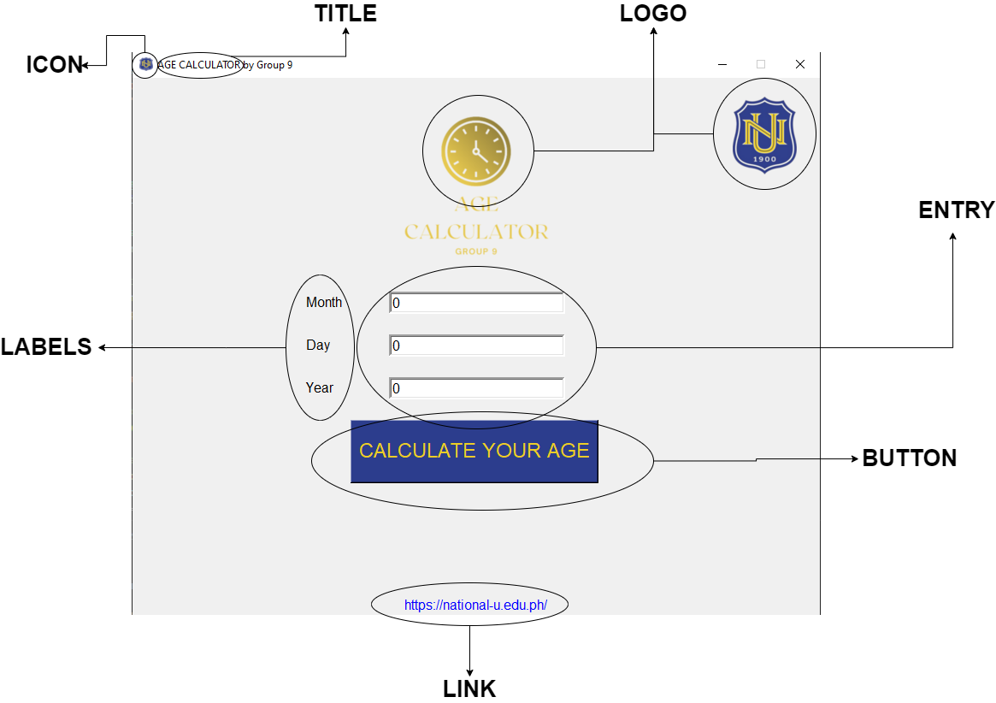
Parts of the window

